Slide 1

Project Title -Keystroke Logger Using Python and Streamlit
By Gaurav Uttam Ghandat

Slide 2

PROBLEM STATEMENT
With the increasing number of cyber threats, organizations and individuals face risks from malicious software such as keyloggers that can capture sensitive information like passwords and personal data. Understanding how keyloggers work is essential for cybersecurity professionals to detect, prevent, and mitigate such threats.
The problem addressed in this project is the lack of practical understanding of OS-level keystroke monitoring techniques and how attackers exploit keyboard input mechanisms.

Slide 3
Project Description
This project implements an educational keystroke logging application using
Python and Streamlit to demonstrate how keystrokes can be captured at the operating system level.
The application uses the pynput library to listen to keyboard events and capture user keystrokes,
while Streamlit provides an interactive web-based user interface. The logger
starts and stops based on explicit user consent, ensuring ethical usage.
The captured keystrokes are displayed in real time within the application interface. The project focuses on:
Understanding keyboard hooks
Demonstrating credential harvesting techniques
Raising awareness about keylogging attacks
Supporting defensive cybersecurity research
The system is designed strictly for educational and ethical purposes and does not transmit or store data remotely.

Slide 4

WHO ARE THE END USERS?
Cyber Security Students
Ethical Hackers
Security Researchers
Educators and Trainers
Blue Team / Red Team Practitioners

Slide 5

Technology Used
Technology | Purpose
Python | Core programming language
Streamlit | Web-based user interface
pynput | OS-level keyboard event listener
Visual Studio Code | Development environment
Windows OS | Testing platform

Slide 6
RESULTS
Successfully captured OS-level keystrokes
Implemented start/stop control with user consent
Displayed logged keystrokes in a clean UI
Prevented application crashes by handling special keys
Demonstrated real-world keylogging behavior
The project effectively showcases how keyloggers operate and how such threats can be analyzed in cybersecurity environments.
Demo Link

Slide 7
DEMO LINK
Github Repo : https://github.com/GauravGhandat-23/Keystroke-Logger

Slide 8
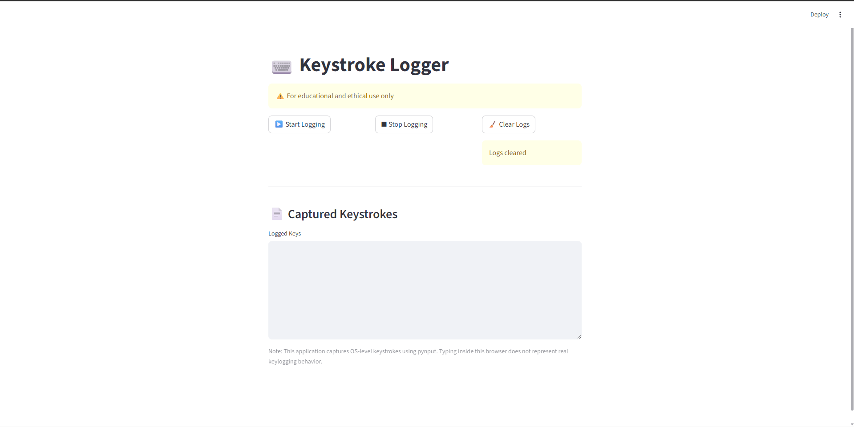
SCREENSHOTS
Home Page UI

Slide 9
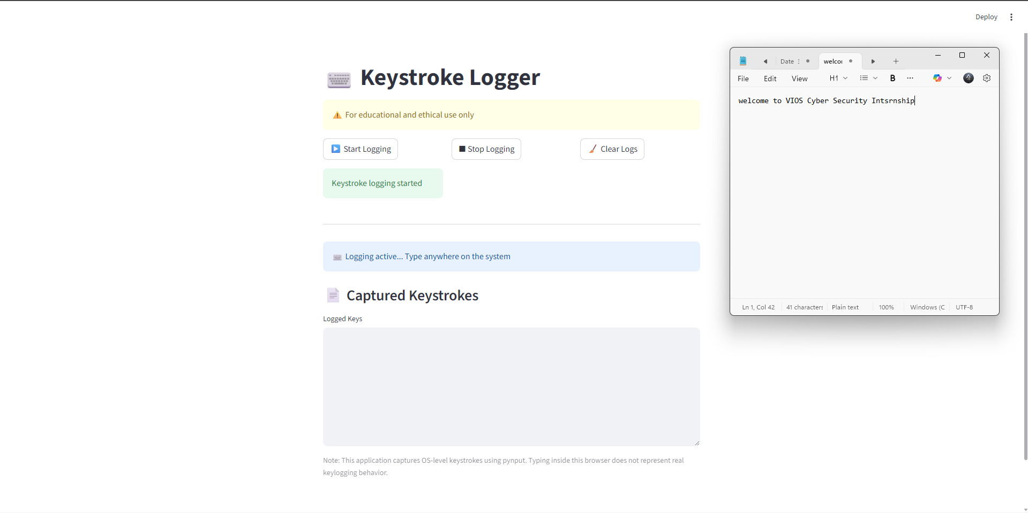
SCREENSHOTS
Start Logging Button

Slide 10
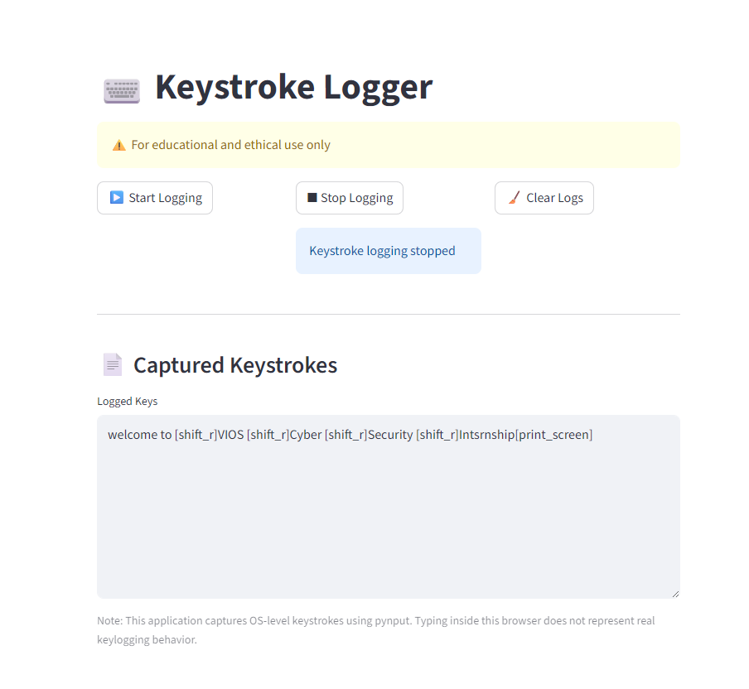
SCREENSHOTS
Captured Keystrokes Output

Slide 11
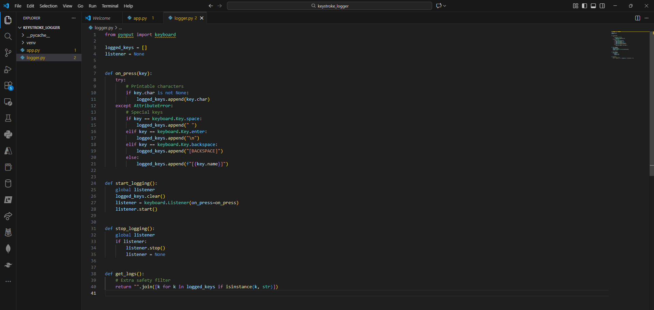
SCREENSHOTS
Logger Code (logger.py)

Slide 12
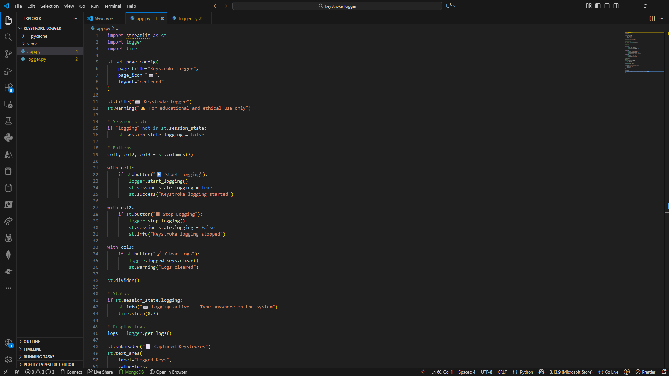
SCREENSHOTS
Streamlit App Code (app.py)

Slide 13
Thank you
Thank you for reviewing this project.
.
.

